Slide 1
Analysis of Financial Statements

Slide 2
Meaning
The process of critical evaluation of the financial information contained in the financial statements in order to understand and make decisions regarding the operations of the firm is called ‘Financial Statement Analysis’
The term ‘financial analysis’ includes both ‘analysis and interpretation’.
The term analysis means simplification of financial data by methodical classification given in the financial statements.
Interpretation means explaining the meaning and significance of the data.

Slide 3
Objectives
To assess the current profitability and operational efficiency of the firm as a whole as well as its different departments so as to judge the financial health of the firm.
To ascertain the relative importance of different components of the financial position of the firm.
To identify the reasons for change in the profitability/financial position of the firm.
To judge the ability of the firm to repay its debt and assessing the short-term as well as the long-term liquidity position of the firm.

Slide 4
Tools of Analysis of Financial Statements
Comparative Statements: These are the statements showing the profitability and financial position of a firm for different periods of time in a comparative form to give an idea about the position of two or more periods.
Common Size Statements: These are the statements which indicate the relationship of different items of a financial statement with a common item by expressing each item as a percentage of that common item.
Trend Analysis: It is a technique of studying the operational results and financial position over a series of years.
Ratio Analysis: It describes the significant relationship which exists between various items of a balance sheet and a statement of profit and loss of a firm.

Slide 5
Comparative Statements
These statements refer to the statement of profit and loss and the balance sheet prepared by providing columns for the figures for both the current year as well as for the previous year and for the changes during the year, both in absolute and relative terms.
The figures in the comparative statements can be used for identifying the direction of changes and also the trends in different indicators of performance of an organisation.

Slide 6
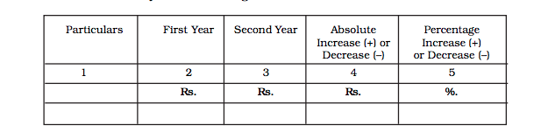

Slide 7
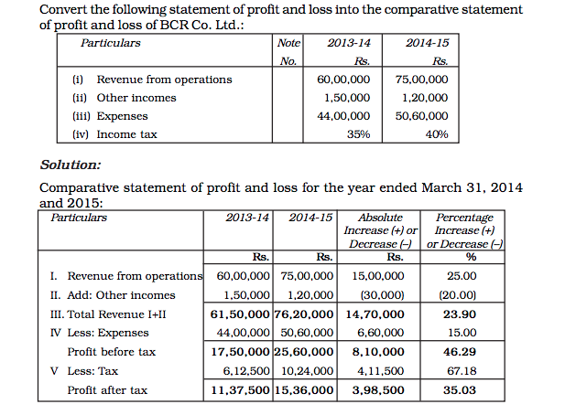

Slide 8
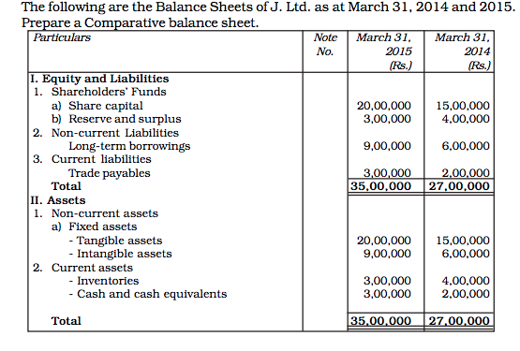

Slide 9
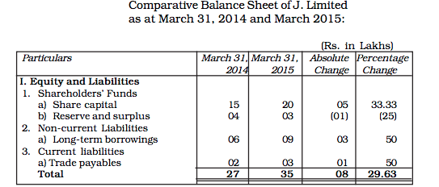
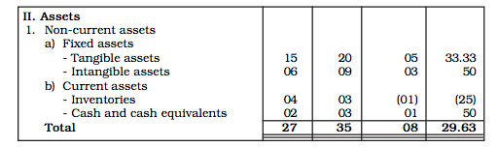

Slide 10
Common Size Statement
Common Size Statement, also known as component percentage statement, is a financial tool for studying the key changes and trends in the financial position and operational result of a company.
Each item in the statement is stated as a percentage of the aggregate, of which that item is a part.
For example, a common size balance sheet shows the percentage of each asset to the total assets, and that of each liability to the total liabilities.
In the common size statement of profit and loss, the items of expenditure are shown as a percentage of the net revenue from operations. I

Slide 11
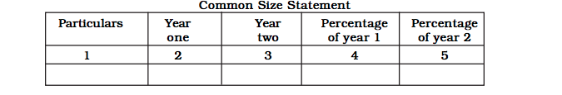
Problems

